Slide 1
Generators and speed control used in wind power energy
Small wind turbines are equipped with DC generators of up to a few kilowatts in capacity
Modern wind turbine systems use three phase AC generators
The common types of AC generator are
Squirrel-Cage Induction Generator (SCIG)
Wound-Rotor Induction Generator (WRIG)
Doubly-Fed Induction Generator (DFIG)
Synchronous Generator (With external field excitation)
Permanent Magnet Synchronous generator (PMSG)
Induction generator (IG) has been extensively used in commercial wind turbine units because it provides some degree of flexibility when the wind speed is fluctuating.

Slide 2
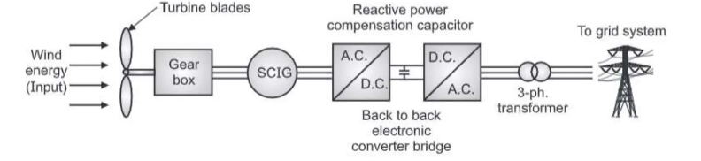
Squirrel Cage Induction Generator (SCIG)

Slide 3
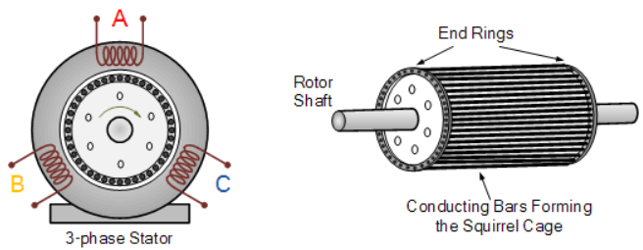
Structure of SCIG
A SCIG is similar to a squirrel-cage induction motor. It mainly consists of:
1. Stator
Three-phase laminated core
Three-phase copper windings
Connected to grid or capacitor bank
Produces a rotating magnetic field when energized
2. Rotor (Squirrel Cage Type)
Laminated iron rotor core
Aluminum or copper bars placed in rotor slots
End rings short-circuit rotor bars → forms a “cage”
No external rotor connections (simple and rugged)
3. Shaft & Bearings
Mechanical power input from turbine/engine
Smooth rotation with low friction

Slide 4
Squirrel-cage induction motor as generator
A SCIM becomes a generator by being driven mechanically faster than its synchronous speed, requiring external capacitors for reactive power (self-excitation) to establish a magnetic field, converting mechanical energy into electricity but needs grid or capacitor bank for excitation and can't self-start generation.
How it Works as a Generator:
Prime Mover: Mechanical energy from wind rotates the rotor faster than the magnetic field's synchronous speed (above synchronous speed), causing slip to become negative.
Magnetic Field: The stator windings are connected to capacitors (or the grid) to provide the necessary reactive power (magnetizing current) to create the magnetic field.
Induction: This rotating magnetic field cuts the rotor bars, inducing currents and generating a torque that opposes the rotation (generating torque).
Output: The machine then produces three-phase AC power, typically with a sinusoidal waveform if designed well.

Slide 5
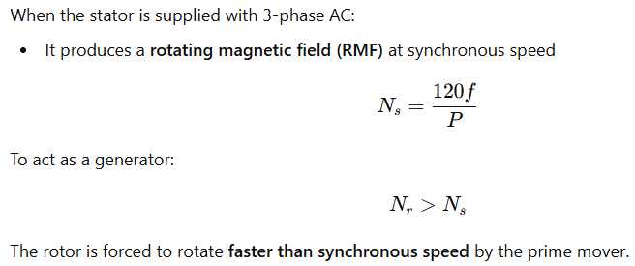
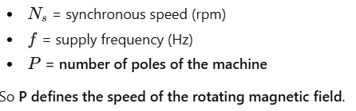
Squirrel-cage induction motor as generator

Slide 6
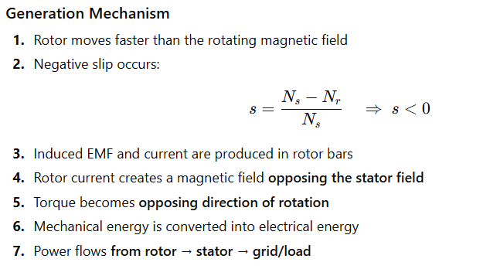
Squirrel-cage induction motor as generator

Slide 7
Squirrel Cage Induction Generator (SCIG)
This generator is simple in construction and coupled to the turbine through gear box. It is a constant speed generator.
This type of generator can be a squirrel-cage induction or a synchronous or wound rotor generator which is connected to the grid via a back-to-back voltage source converter bridges
A synchronous generator is used to produce variable frequency AC power.
To compensate reactive power, capacitor bank is connected to cross-lines. This increases active power and also improves power factor.
The power converter connected in series with the wind turbine generator transforms this variable frequency AC power into fixed-frequency AC power
As the power converter has to convert all the stator power, the converter size depends on the stator power rating
Output voltage from generator is stepped-up by step-up transformer to suit the connection to grid system.

Slide 8
Advantages of SCIG
Better wind energy utilization.
Reduces reactive power demand on self-excited capacitor bank.
Very simple in construction, robust size, rugged construction.
Cheaper in cost.
Rectifier can generate excitation current for generator.
Fast transient response.
Few parts, so reliable operation.
No frequency conversion, so no problem of current harmonics.

Slide 9
Disadvantages of SCIG
Noisy operation.
Power converter is costly.
It has very low efficiency.
Additional components such as reactive power compensator is required in the circuit.
For smooth grid connection, a soft starter is required.
Gear box maintenance is frequent, so cost increases.

Slide 10
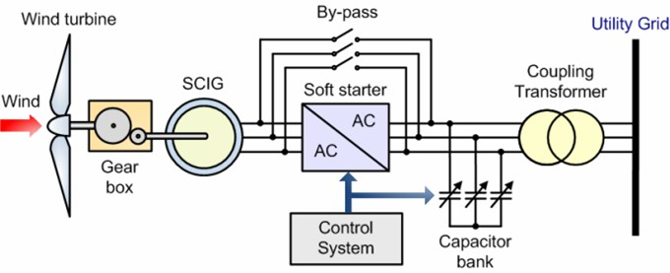
Fixed speed with capacitor bank

Slide 11
Fixed speed with capacitor bank
Fixed-Speed Induction Generator (FSIG) based wind turbines employ a squirrel-cage induction generator (SCIG) directly connected to grid
The rotor of a fixed-speed wind turbine rotates at fixed speed determined by the frequency of the grid.
SCIG always draws reactive power from the grid
A capacitor bank is used to provide reactive power compensation
It is typically achieved by continuously switching capacitor banks (5-25 steps) according to the active power generated.
Smoother grid connection was achieved by a soft-starter

Slide 12
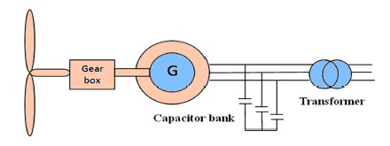
Fixed speed with capacitor bank
Simplified diagram

Slide 13
Fixed speed with capacitor bank
In fixed speed, the wind fluctuations are converted into mechanical fluctuations and further into electrical power fluctuations that leads to voltage fluctuations.
Because of these voltage fluctuations, the fixed speed wind turbine draws fluctuating reactive power from the utility grid (in the case of no use of capacitor bank), which increases both the voltage fluctuations and the line losses
Advantages: Simplicity and low cost
Disadvantages: the requirement of a stiff grid (fixed voltage and frequency), a robust mechanical structure is required to support the high mechanical stress caused by wind gusts.

